Slide 1
Nuclear Fuel Concepts
Benjamin Beeler
Assistant Professor
Department of Nuclear Engineering
North Carolina State University
bwbeeler@ncsu.edu

Slide 2
Fuel is the Heat Source
Fuel functions as a heat source, generating heat that is transferred to a coolant, which transfers heat through external loops, heat exchangers, etc., to run a generator
While the fuel must meet neutronic requirements, limiting possible options of materials choice, the lifetime of the fuel is governed by material constraints
What I care about is how the fuel material evolves/behaves as a function of time

Slide 3
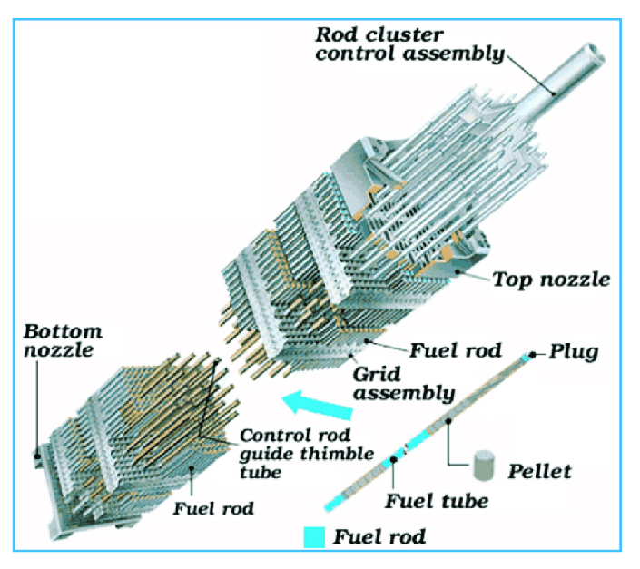
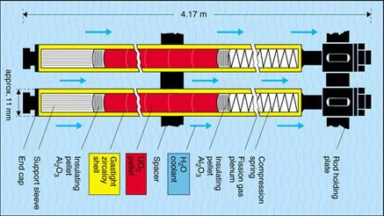
Fuel System
Fissile material compound (fuel), surrounded by a cladding, surrounded by coolant
Fuel generates your neutrons and heat, while cladding keeps the nasty stuff in the fuel from getting to the coolant
Coolant transports the heat away to secondary systems
Coolant can also reduce energy of (moderate) neutrons
I focus on the fuel here, but this concept of a fuel system is more complete

Slide 4
Fuel is limited to select elements
A fissionable nuclide is capable of undergoing fission (even with a low probability) after capturing a high energy neutron
A fissile nuclide is capable of sustaining a nuclear fission chain reaction with neutrons of any energy
A fertile material is a material that, although not itself fissionable, can be converted into a fissile nuclide by neutron absorption and subsequent nuclei conversions.
U-235 is a fissile isotope that naturally occurs in uranium in small amounts (0.7%). Can be enriched.
Neutron + Target Nucleus -> Two fission products, 2-3 neutrons; Fission releases around 210 MeV of energy

Slide 5
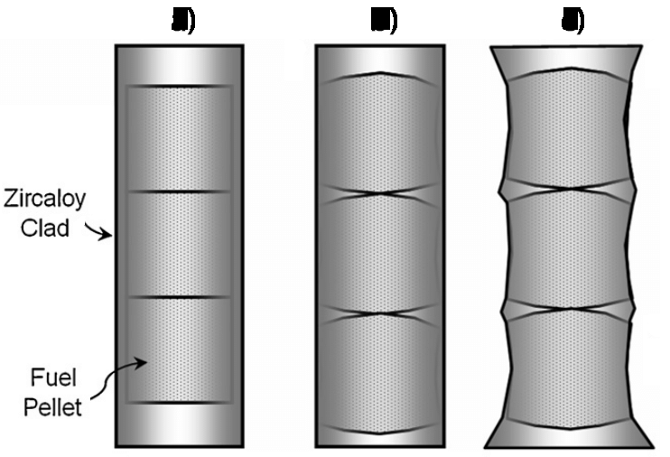
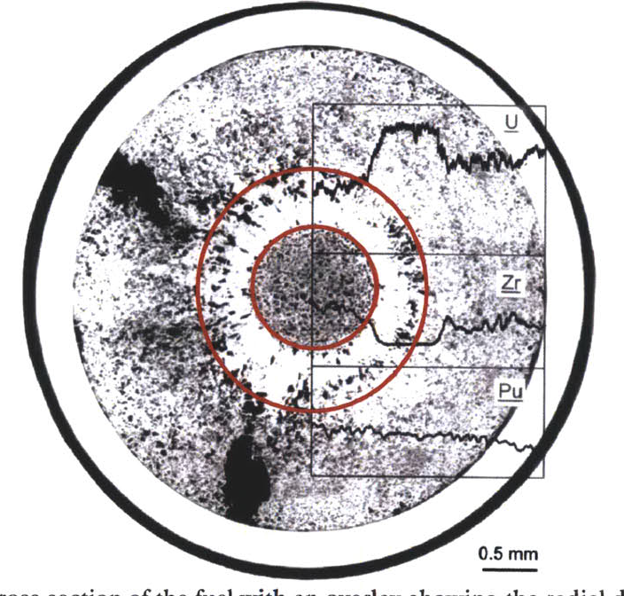
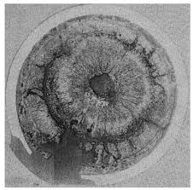
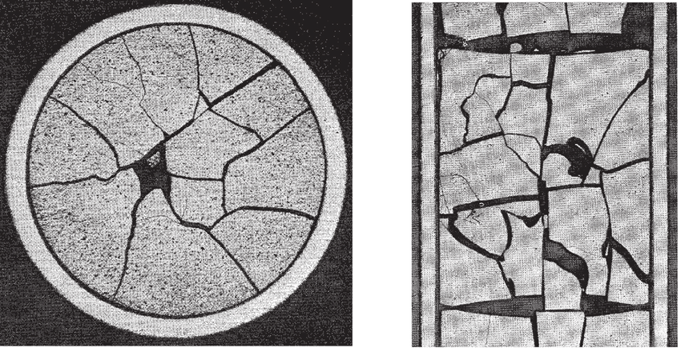
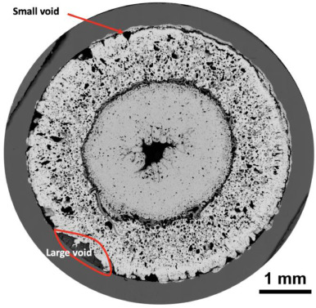
Fuel Considerations
Safety:
Stable and predictable behavior
No melting, no phase changes under transients that lead to deleterious behavior
Uranium density
Mechanical integrity
Cladding interactions
Swelling and fission gas release
Operating temperatures

Slide 6
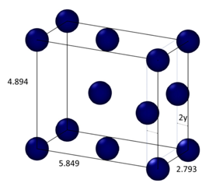
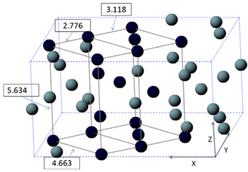
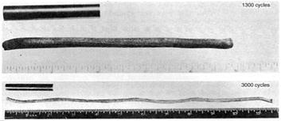
Why not use pure uranium metal?
Pure uranium has three solid phases
α-phase is orthorhombic
β-phase is tetragonal
γ-phase is body-centered cubic
During thermal cycling, pure uranium dramatically swells
α-U has both anisotropic thermal expansion and anisotropic irradiation growth
Alloy U with transition metals or form U compounds with O, C, N, etc.

Slide 7
Uranium Dioxide (UO2)
Reference fuel for nuclear power industry
Single phase, fluorite structure
Fabrication via sintering UO2 powder into pellets
Water coolant
Pellets are stacked inside Zircaloy cladding tubes (zirconium alloy)
Good behaviors
Very high melting point, about 2800 C
Maintains a stable fluorite phase up to melting
Very compatible with Zircaloy clad Relative stability in water
Reasonably radiation resistant

Slide 8
Uranium Dioxide (UO2)
Bad behaviors
Brittle (thermal stress fractures, fragmentation)
Poor thermal conductivity
Properties very sensitive to stoichiometry
Limited linear heating rates
Non-negligible thermal expansion/swelling
Higher stored thermal energy than other fuel material

Slide 9
Uranium Dioxide (UO2)
Critical Phenomena
Thermal conductivity (and degradation)
Fission gas release, leading to pressure increase inside the cladding
Fuel fragmentation and relocation under transients
Bambooing creating stress concentrations
All 94 operational reactors in US utilize UO2
we sufficiently understand its limitations, and don’t push it beyond

Slide 10
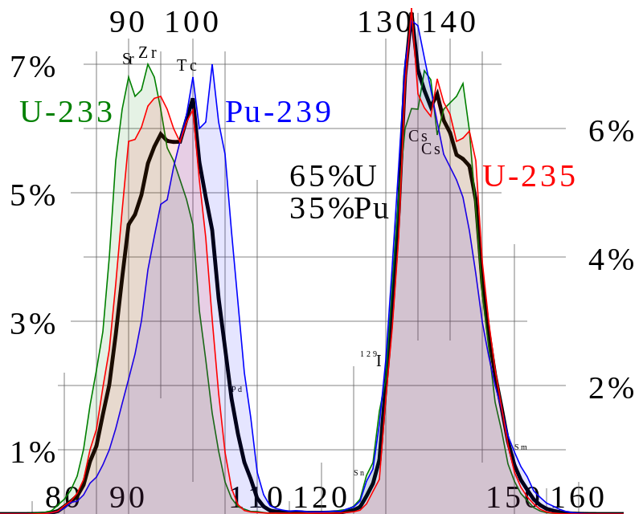
Fission Product Generation
Fission releases around 200 MeV
The fission fragments have 169 MeV of kinetic energy
2 to 3 neutrons with an average energy of 2 MeV
7 MeV of prompt gamma ray photons
The remaining energy is released by beta decay
Every fission product that is produced is now in the crystal lattice of the fuel, changing the microstructure

Slide 11
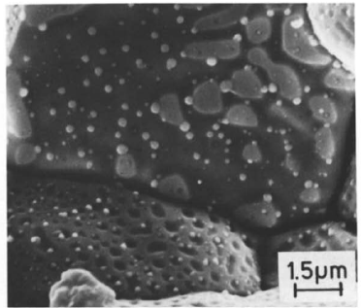
Various types of fission products in the fuel
Soluble oxides (Y, La and the rare earths)
Dissolved in the cation sublattice
Insoluble oxides (Zr, Ba and Sr)
Form insoluble oxides in the fluorite lattice
Metals (Mo, Ru, Pd, and Tc)
Form metallic precipitates
Volatiles (Br, Rb, Te, I and Cs)
Exist as gases at high temperatures of the pellet interior
Also exist as solids at the cooler pellet exterior
Noble gases (Xe, Kr)
Essentially insoluble in the fuel matrix
Form either intragranular (within grain) voids or bubbles or intergranular (grain boundary) bubbles

Slide 12
Fission products impact the behavior of the fuel

Slide 13
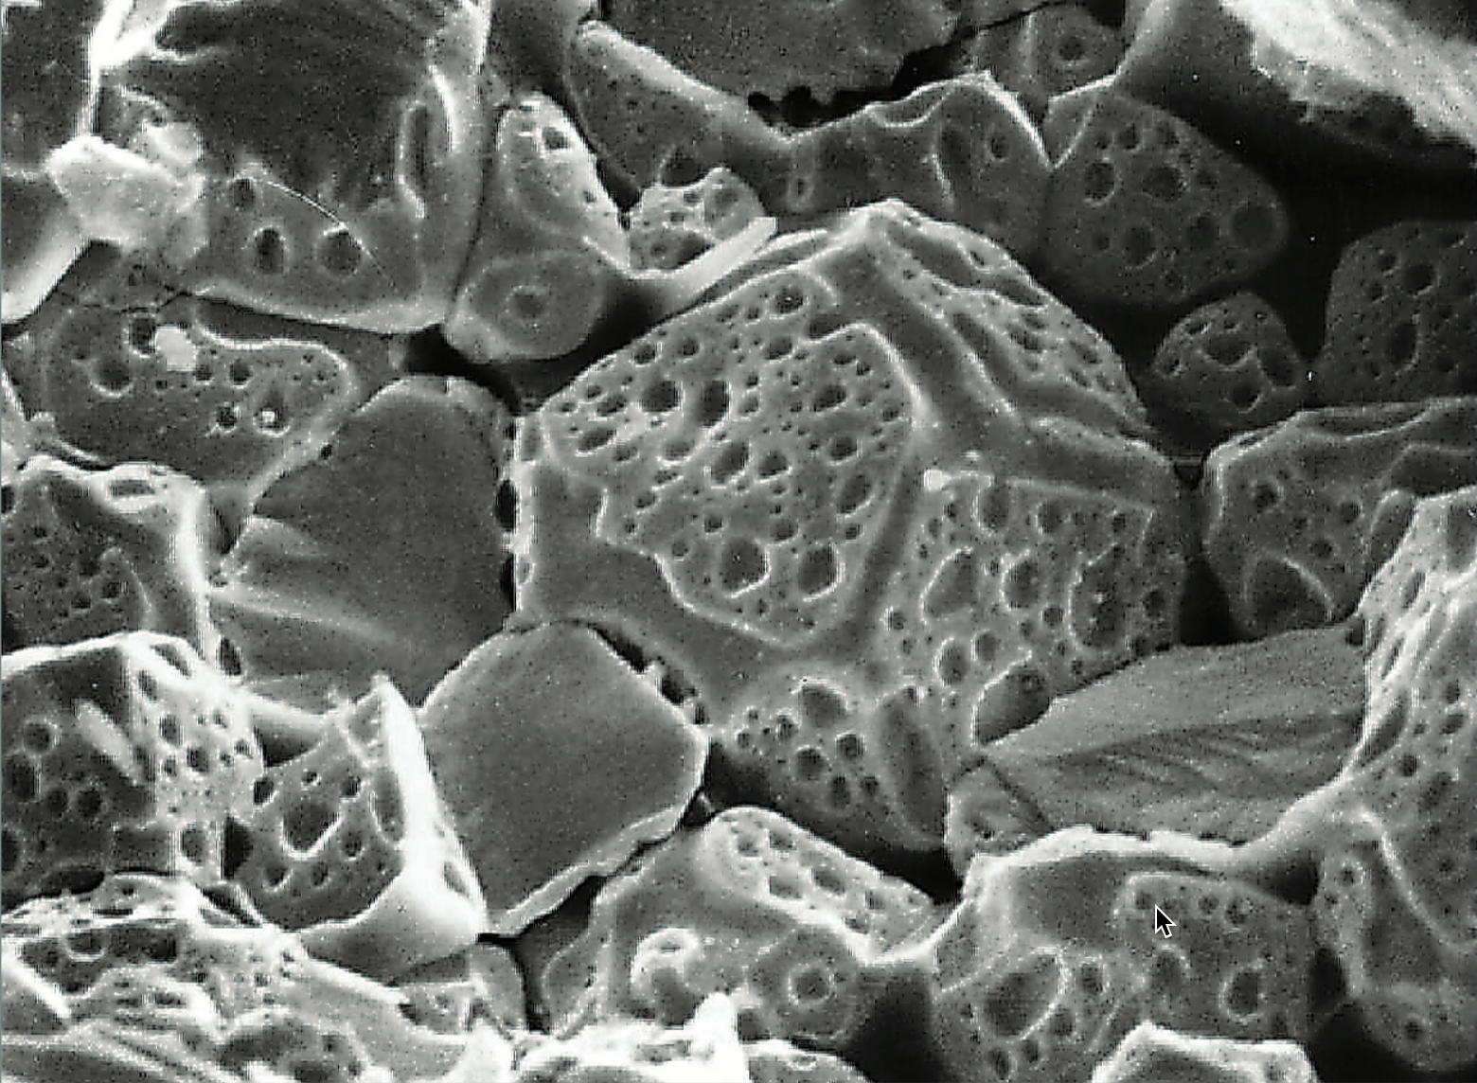
Fission Gas Release
Fission gases (Xe, Kr) are released in a process composed of three stages in UO2
Stage 1: Gas atoms are produced throughout the fuel due to fission and diffuse towards grain boundaries
Stage 2: Gas bubbles nucleate on grain boundaries, growing and interconnecting
Stage 3: Gas travels through interconnected bubbles to a free surface

Slide 14
Advanced Fuel Types and Associated Reactor Types
Mixed Oxide (MOX) and Accident tolerant fuel (ATF) – Light Water Reactors
UZr – Sodium Cooled Fast Reactors
UMo – Research Reactors
UC/UCO – High Temperature Gas Reactors
UF4/UCl3 – Molten Salt Reactors

Slide 15
Mixed Oxides
UO2 can be combined with PuO2 for a mixed oxide (MOX) fuel for use in fast reactors
fast reactor uses higher energy neutrons
Allows to burn excess weapons grade plutonium, or breed additional fuel isotopes
Less common is inclusion of minor actinides in MOX to burn waste
~30 reactors in Europe currently utilize a partial MOX core
Similar behavior to UO2, but different neutronics, fission gas release, thermal conductivity, etc.

Slide 16

Accident Tolerant Fuel/Advanced Technology Fuel
Cr-doped UO2
Larger grain size, theoretically reduced fission gas release
Cr changes the O potential present within the fuel, changing defect concentrations and mobilities
Coatings or alternate claddings – FeCrAl or SiC
Improved radiation resistance, corrosion resistance, etc.

Slide 17
Uranium-Zirconium (UZr)
Utilized in sodium cooled fast reactors (SFRs) - EBR I, EBR II
Varied crystal structure and compositional environment
Easily alloyed with Pu, minor actinides (MA)
Can function as a breeder/burner fuel
Sodium coolant
Fe-based cladding
Alloy with Zr to increase the melting point and to stabilize the high temperature body-centered cubic phase
Terrapower building Natrium reactor with UZr fuel

Slide 18
Uranium-Zirconium (UZr)
Phenomena of interest
30-50% swelling
Constituent redistribution
Alpha tearing
FCCI
Good: High thermal conductivity; Stability to high burnups (> 20%); Flexible composition; Inherent safety- negative reactivity feedback, etc.
Bad: Low melting point; Dramatic fuel swelling that must be accounted for; Incredibly complex microstructures; Fuel-Clad Chemical Interaction, Easily oxidized, etc.

Slide 19

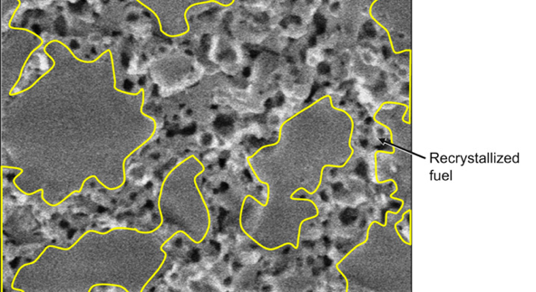
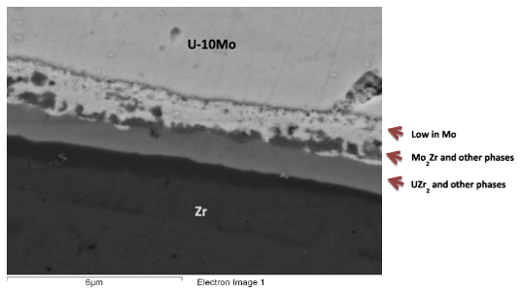
Uranium-Molybdenum (UMo)
New fuel being qualified for research reactors
Fuel foil, with Zr diffusion barrier, Al cladding
Will be utilized in ATR, NBSR, MITR, MURR
Phenomena: Decomposition; Fission Gas Superlattice; Recrystallization; Interdiffusion region; Carbides

Slide 20
TRISO Particle Reactors
High temperature gas reactors (HTGRs) or molten salt reactors (MSRs) can utilize TRISO particles as the fuel source
Pebble bed and prismatic types of HTGRs
Particles are agglomerated with graphite into a larger pebble, or into a cylindrical block
Current designs utilize UCO (in the US), which is a heterogeneous mixture of UO2 and UC fuel
Helium cooled gas or molten salt cooled
X-energy and Kairos pursuing TRISO-fueled reactors

Slide 21
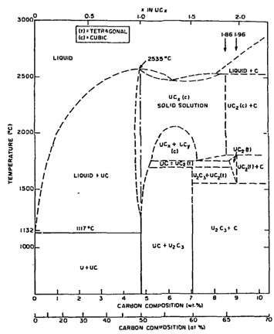
UC/UCO TRISO Fuels
TRISO: TRistructural ISOtropic particle fuel
Layered fuel in mm-sized particles
Layers:
Fuel Kernel
Buffer
Inner Pyrolitic Carbon (IPyC)
SiC
Outer Pyrolitic Carbon (OPyC)
Can appear as UC, U₂C₃, or UC₂
Advantages
High thermal conductivity
High fuel density
Thermally stable
High melting temperature
Disadvantages
Rapidly corrodes in water
Reacts with some cladding

Slide 22
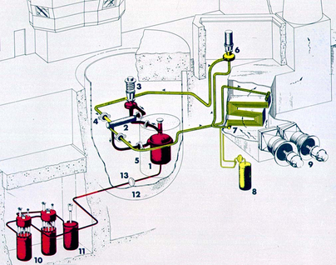
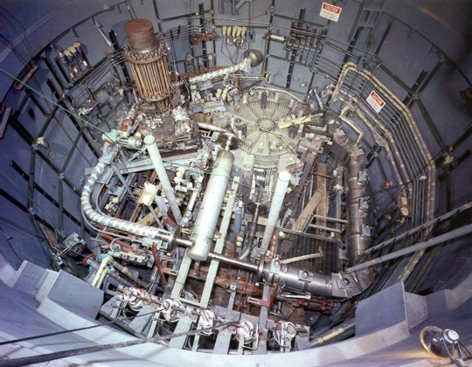
Molten Salt Reactors
Utilize molten salt (alkali/alkaline-halides), e.g., NaCl, as a heat transfer medium, functioning as coolant, fuel, or both
The molten salt reactor experiment (MSRE) operated at Oak Ridge in the 1960s and utilized flowing fuel molten salt: LiF-BeF2-ZrF4-UF4
MSRs can operate at ambient pressures and high temperatures
MSRs have a very large margin to boiling, and combined with a negative reactivity feedback coefficient, have inherent safety

Slide 23
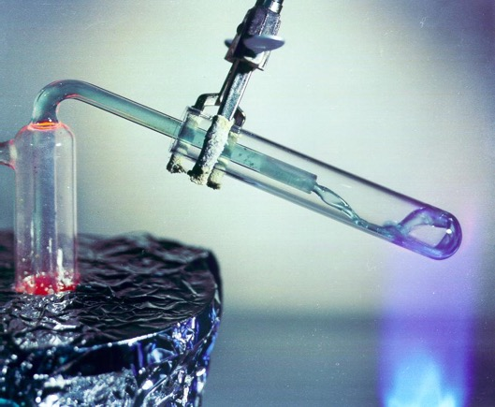
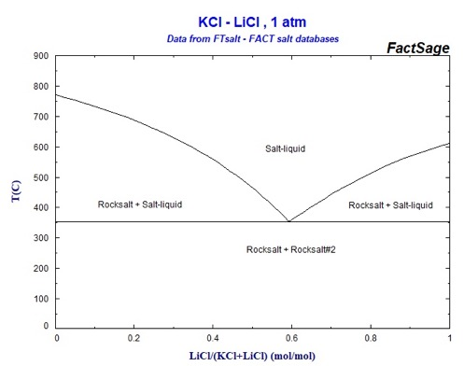
Molten Salt Reactors
Molten salts have high heat capacity, high boiling point, and high thermal conductivity, and can easily absorb fission products
The changing chemical composition of the salt as it is transmuted by reactor radiation leads to changing properties
The corrosivity of hot salts can break down cladding components and leech alloying elements
LWR type reactor structural materials cannot be used, but some Ni alloys and graphite are sufficiently compatible with molten salts
MCRE, Kairos (salt coolant), ThorCon, Copenhagen atomics, and others

Slide 24
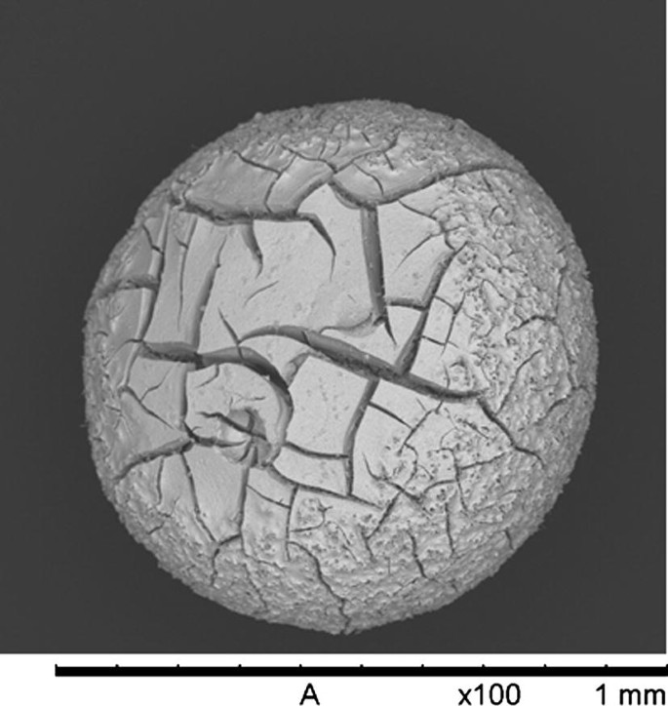
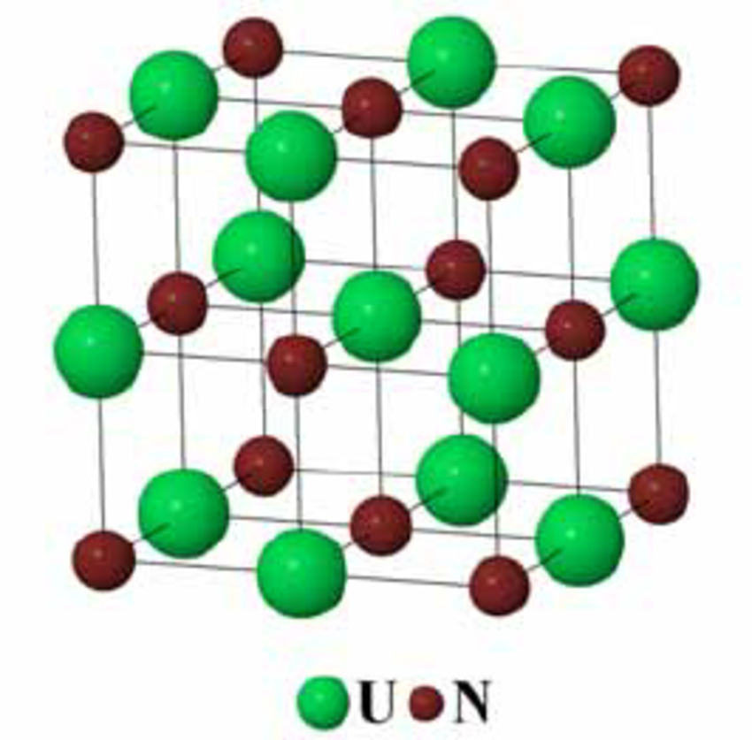
Uranium Nitride
Potential fuel for gas cooled reactors as compacts or TRISO kernels, as well as lead cooled reactors Pb-cooled reactors are similar in concept to SFRs, pool-type
High fissile density, high thermal conductivity, and chemical stability with cladding
Very difficult to manufacture, poor oxidation resistance, requires N-enrichment
Also being explored as a potential accident tolerant fuel for LWRs
Candidate fuel for space reactors

Slide 25
Unique Fuel Designs
KRUSTY
LightBridge
SSR
Kairos

Slide 26

Summary
There exist a number of nuclear fuels in different stages of utilization and development
The more established ones are the less interesting ones… but still have a lot to understand
Active research on existing, underutilized, and developmental fuel designs
Each reactor design or application has individual needs, and no one fuel is one size fits all
Need to balance safety, performance (normal, off-normal, extended), manufacture, processing, waste, etc.

Slide 27
How do we model advanced fuels?

Slide 28
My viewpoint/approach
Scientifically informed engineering is a multiscale problem
Critical phenomena need to be identified from the macroscale, and informed from the lower length scales
Perform good science, sometimes for science’s sake, but often to address a key engineering problem or need

Slide 29
Atomistic Modeler’s Toolkit
Density Functional Theory (DFT)
is a computational quantum mechanical modelling method used to investigate the electronic structure of many-body systems, in particular atoms, molecules, and the condensed phases
Molecular Dynamics (MD)
is a computer simulation method for analyzing the physical movements of atoms and molecules, determined by numerically solving Newton's equations of motion for a system of interacting particles
Yashima, https://doi.org/10.1039/C0CC00573H
Sand, https://doi.org/10.1016/j.jnucmat.2018.08.049

Slide 30
Atomistic Modeler’s Toolkit
ab initio Molecular Dynamics (AIMD)
is a computer simulation method in which finite temperature molecular dynamics (MD) trajectories are generated with forces obtained from accurate 'on the fly' electronic structure calculations
hybrid mixing between the accuracy of electronic structure calculations, while allowing for real temperature effects to be considered
Schnappinger, https://doi.org/10.1039/C7CP05061E
Yazyev, https://doi.org/10.1007/s00214-005-0052-6

Slide 31
DFT applied to Nuclear Fuels
Since we are dealing with the electronic structure, these calculations are very computationally expensive and limited to a few hundred atoms
Typically employed to calculate lattice constants, elastic constants, point defects, electronic densities, phonon DOS, etc.
DFT on advanced nuclear fuels has really only existed for about 15 years

Slide 32
DFT applied to Nuclear Fuels

Slide 33
MD applied to Nuclear Fuels
MD can span longer time scales and larger length scales, up to millions of atoms and nanoseconds
These simulations require interatomic potentials capable of accurately predicting a number of properties
No interatomic potentials for advanced nuclear fuels existed prior to about 15 years ago
Potential development is still a major area for research

Slide 34

MD applied to Nuclear Fuels

Slide 35
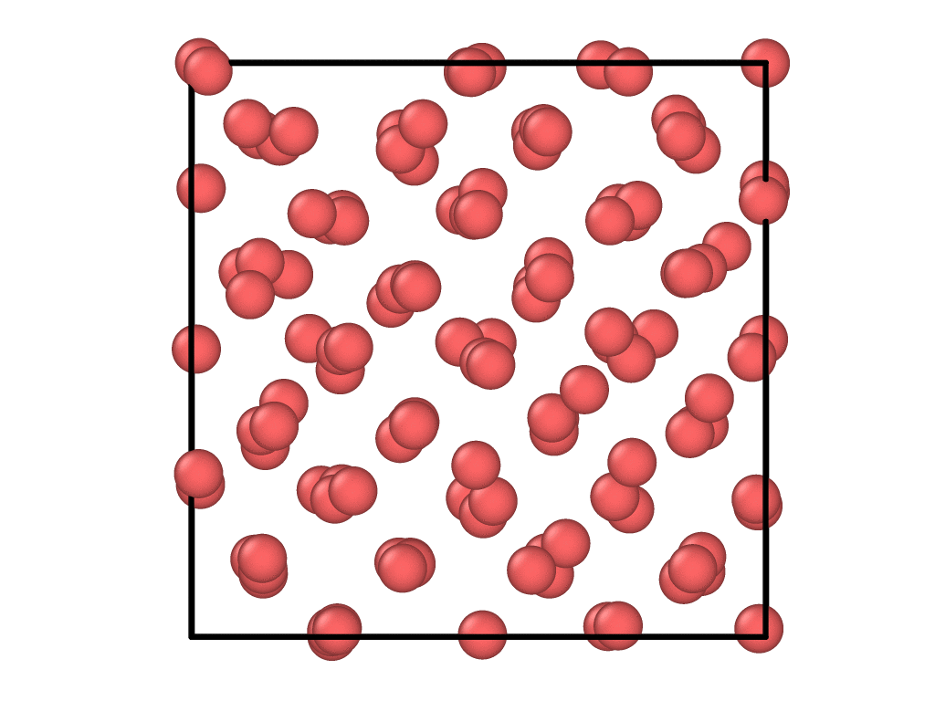
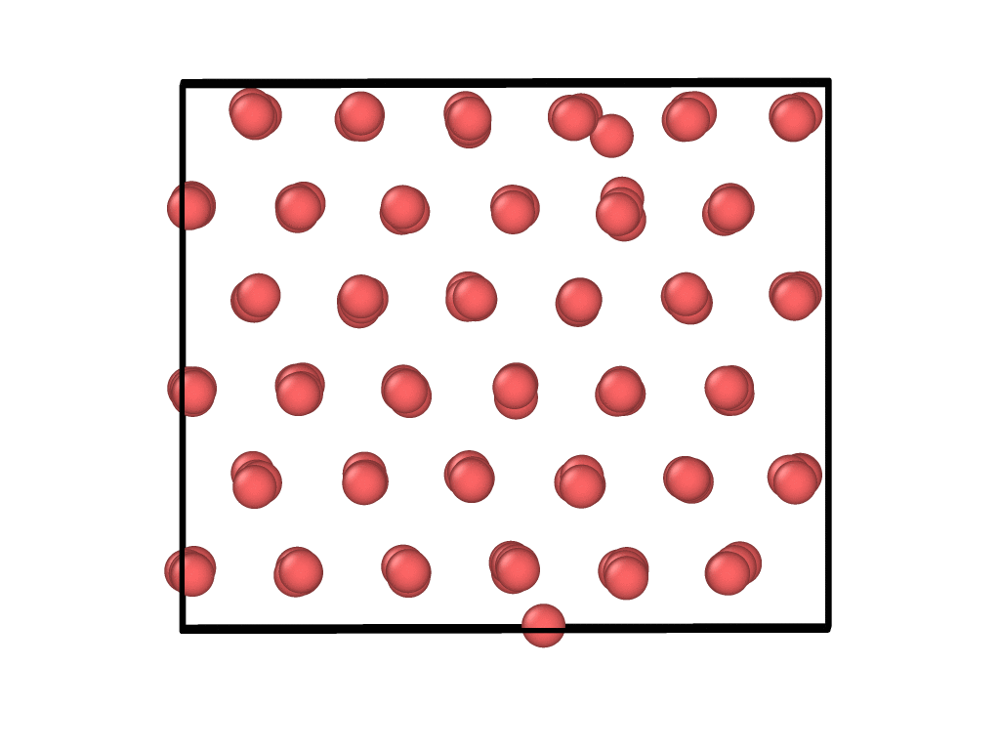
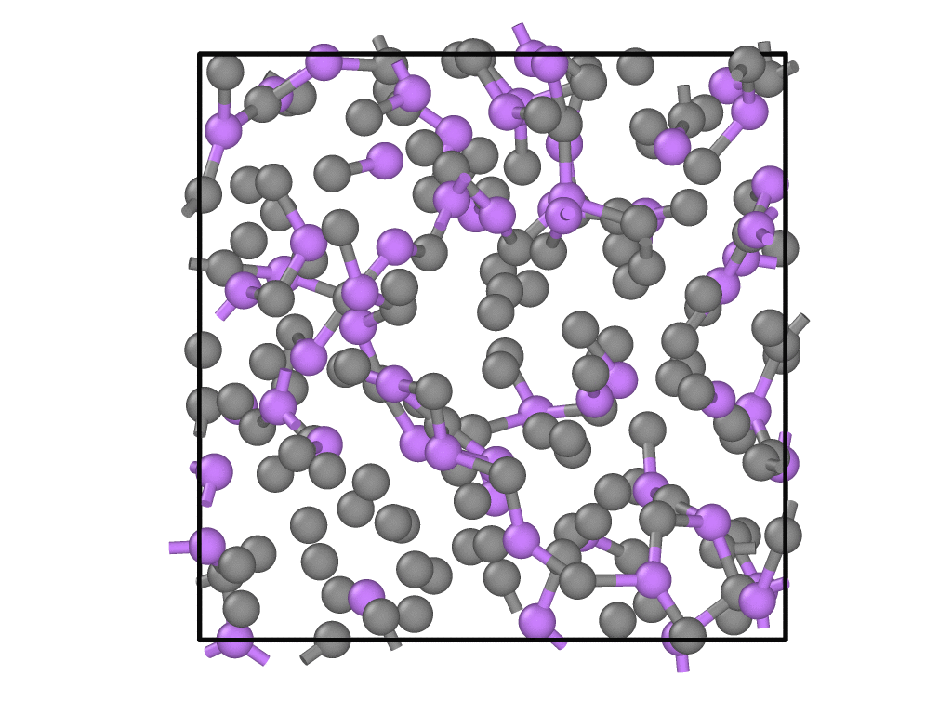
AIMD applied to Nuclear Fuels
BCC U
Alpha U with int
Eutectic LiCl-KCl

Slide 36
Integration into Fuel Performance Models

Slide 37
Integration into Fuel Performance Models
BISON is the multiphysics MOOSE-based fuel performance code developed under NEAMS and includes thermal transport, stress, and underlying material evolution, etc.
BISON requires models for material properties and how they evolve during operation
A lot of these fundamental properties are unknown, and too difficult to obtain experimentally
Lower Length Scale Modeling!

Slide 38
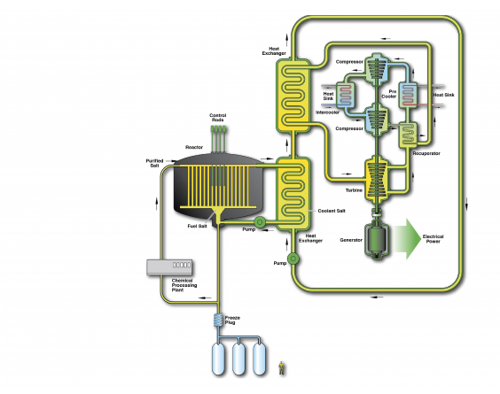
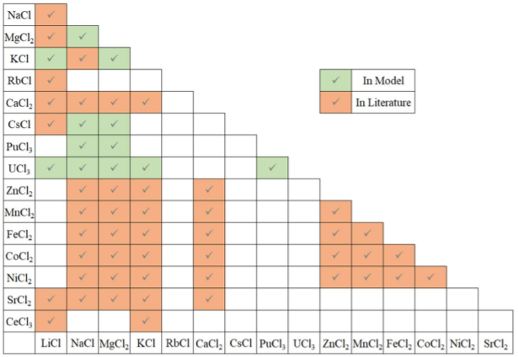
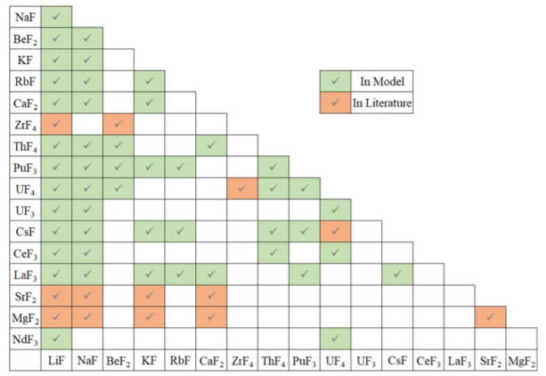
Molten Salts
Applications of molten salts: Catalysis; Metal production; Solar power; Thermal energy storage; Pyroprocessing; Molten salt reactors
There is a gap in the fundamental properties of molten salts
These properties are difficult to collect experimentally due to high temperatures, corrosivity, toxicity, etc.
Computational methods are used to supplement the experimental data

Slide 39
What do we do?
Work with experimentalists to target specific salt pseudo-binaries and ternaries and validate computationally determined properties, then expand beyond the experimental data
Apply AIMD to determine density, compressibility, thermal expansion, heat capacity, enthalpy of mixing, etc.
Utilize these calculations to determine transport properties: diffusivity, viscosity, thermal conductivity, etc.

Slide 40
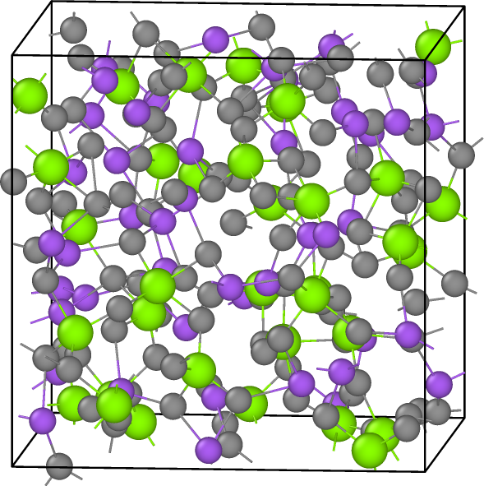
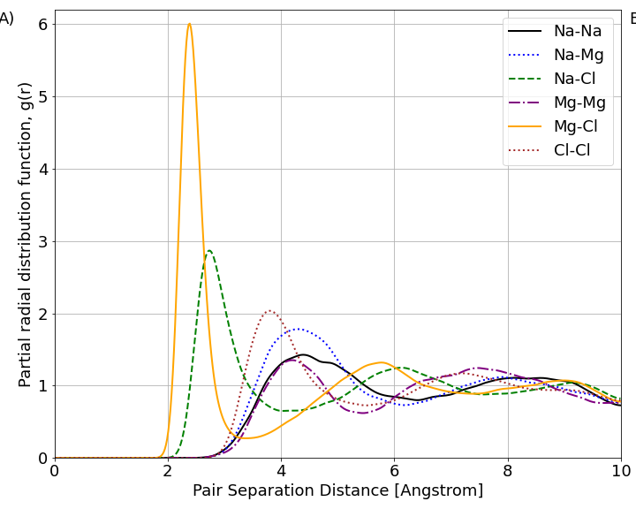
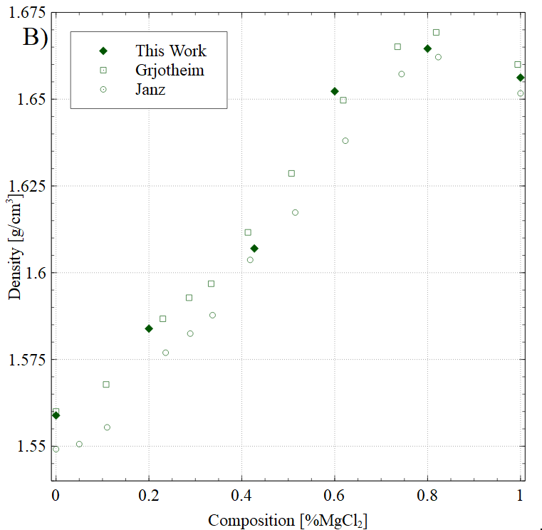
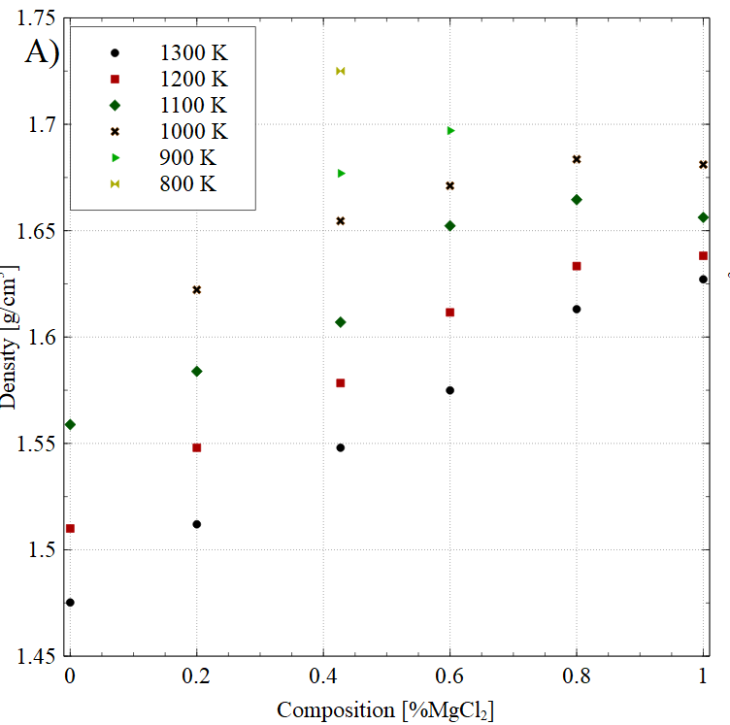
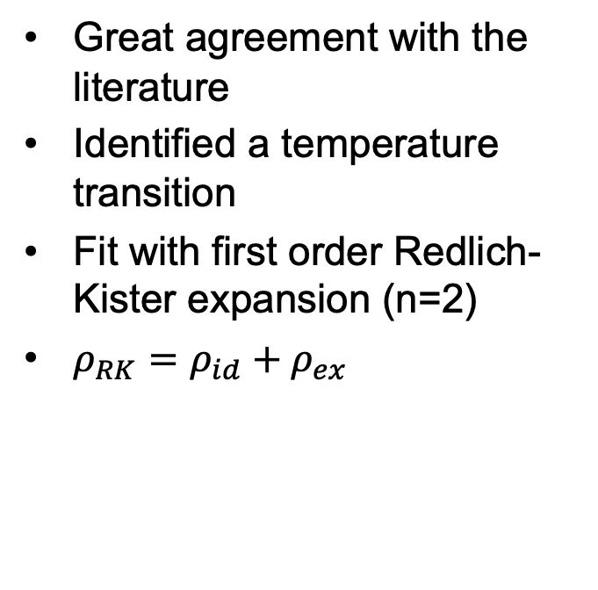

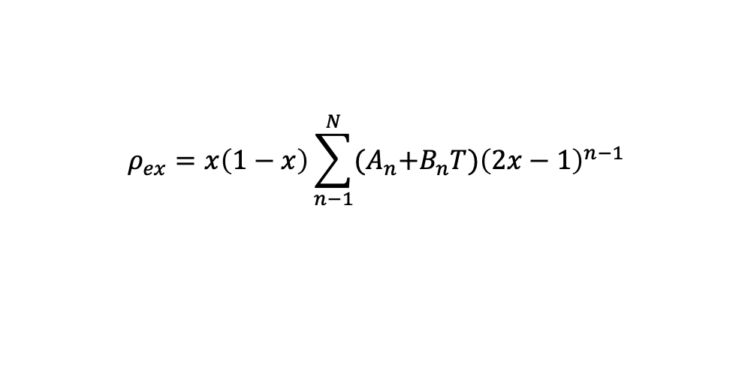
NaCl-MgCl2 Density
Great agreement with the literature
Identified a temperature transition
Fit with first order Redlich-Kister expansion (n=2)
$ρ_{RK}=ρ_{id}+ρ_{ex}$
$$ρ_{ex}=x\left(1−x\right)\sum_{n−1}^{N}{{(A}_{n}+B_{n}T){\left(2x−1\right)}^{n−1}}$$
1100 K
$$ρ_{id}=\frac{\sum_{i}{x_{i}M_{i}}}{\sum_{i }{x_{i}V_{i}}}$$

Slide 41
Summary
Scientifically informed engineering is a multiscale problem
There exist a number of scientific knowledge gaps for advanced nuclear fuels
Atomistic methods (DFT, MD, AIMD) are a rapidly growing area that can fill in a number of these gaps
Atomistic data can be implemented into higher length scale methodologies to increase fidelity of fuel performance simulations

